Slide 1


Notes:
Hello and welcome to the Actimize Fraud Documentation Video.

Slide 2

IFM-X Data Stream Integration
Understanding integration of semi-structured data streams in IFM Component
Notes:
This video talks about Understanding integration of semi-structured data streams in IFM Component.
In this video we’ll talk about how Data stream integration works and the required configurations for the same.

Slide 3
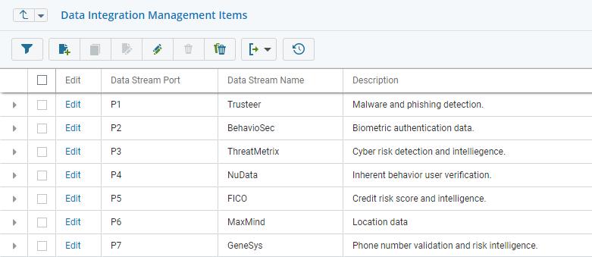
Data Integration Management
Data Integration
Data Management
Data Availability
{
rootingIndicator: "True",
malwareIndicator: "True",
suspiciousAppsIndicator: "True",
deviceID: "44FFBAD^A3",
applicationID: "TTWGSH2300",
devicelogicalname: "MARKLT".
timeZone: "EST,
userID: "MARKSMITH",
sessionID:"832476287AA"
}
Policy Manager
Alerts
Analytics
IDB
Notes:
IFM enables customer to map semi-structured data stream fields to master feed client fields. The mapped fields can later be used when defining policy manager rules, Profiles and Rule components using Platform Lists.
In order to do that, the data streams must be configured in either in the platform lists or in the FF_dataStreamClientFieldMapping.ini file available in the AIS instance folder.

Slide 4
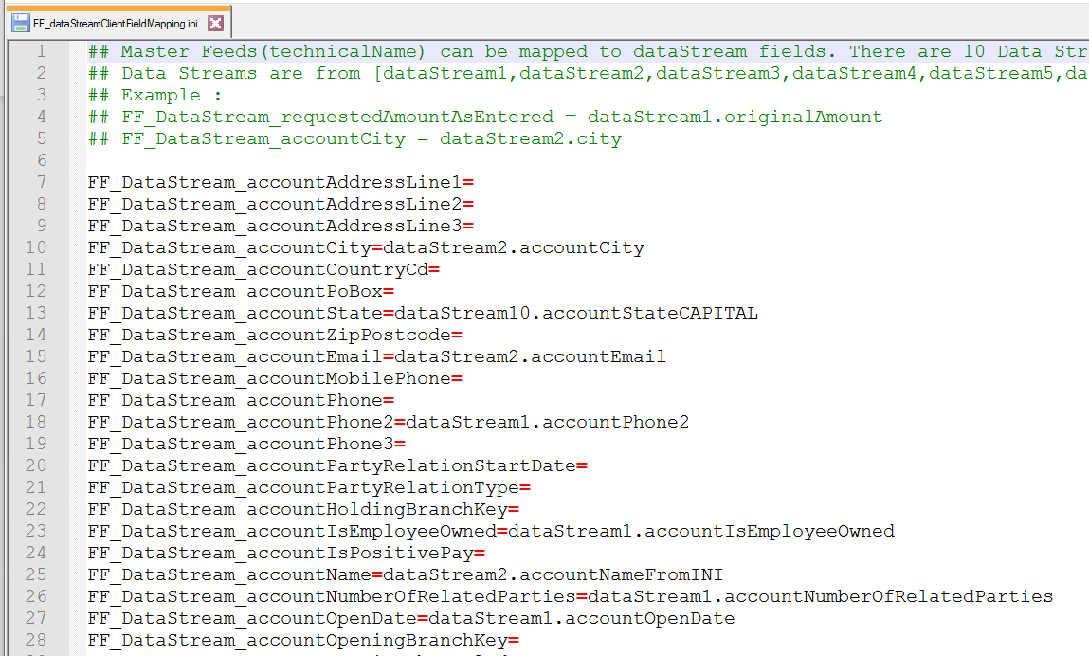
Notes:
Here is an example of the FF_dataStreamClientFieldMapping.ini file.

Slide 5
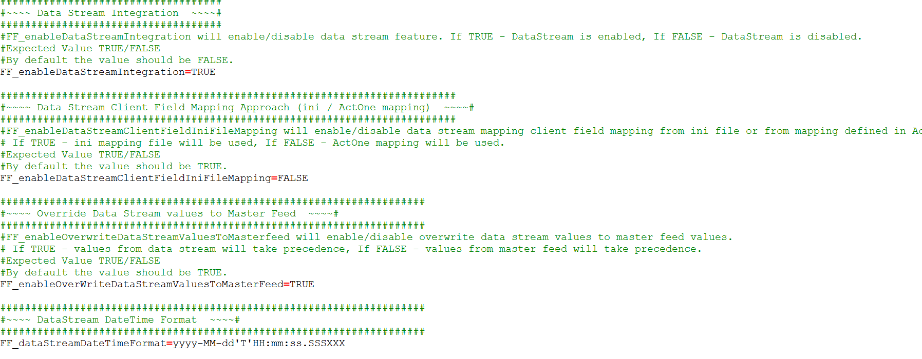
Notes:
Platform list in Actone or FF_dataStreamClientFieldMapping.ini file, that is depends on the value set for FF_enableDataStreamClientFieldIniFileMapping parameter.
If FALSE then Mapping field Consider From ACTONE interface.
The FF_enableDataStreamIntegration parameter must be set TRUE to enable the Data stream Integration feature.
Refer to the implementer guide to know more about other important parameters applicable for Data stream Integration.

Slide 6
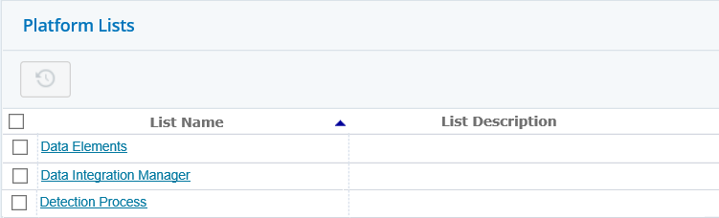
Notes:
Let’s deep dive into the platform lists in ActOne user interface.
Data Integration Manager, Data Elements, and Detection Process platform lists enables you to configure data streams.
The Data Integration Manager wizard allows you to configure the data stream and the fields that are flowing through the data stream.
Data Elements and Detection Process platform lists are nested within the Data Integration Manager. These lists can be updated independently as well.

Slide 7
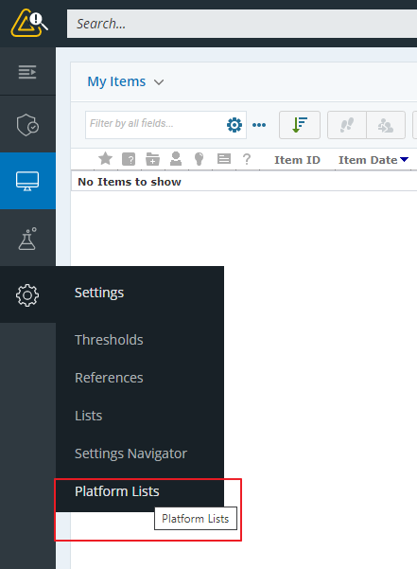
Notes:
Now, let’s see how to Configure Platform Lists for Data Streams.
Once you log on to ActOne, Go to the Settings tab and select Platform Lists.

Slide 8
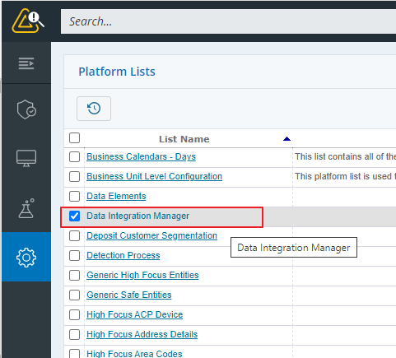
Notes:
From the Platform List Items select Data Integration Manager

Slide 9
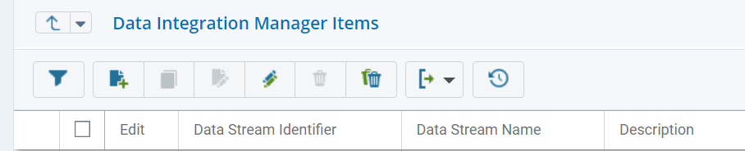
Notes:
Click the new item icon to add a new platform list.
It opens the New Platform List Item wizard.

Slide 10
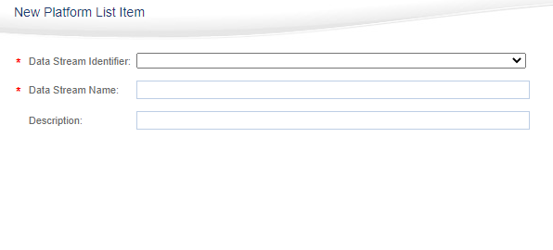
Notes:
In the Data Stream Identifier field, select a data stream field from the existing data streams. This field is a mandatory field and should be unique.
In the Data Stream Name field, specify the business name to be displayed for the data stream. The value must be unique with maximum length of 50 character.
In the Description field, specify additional information related to the data stream.

Slide 11
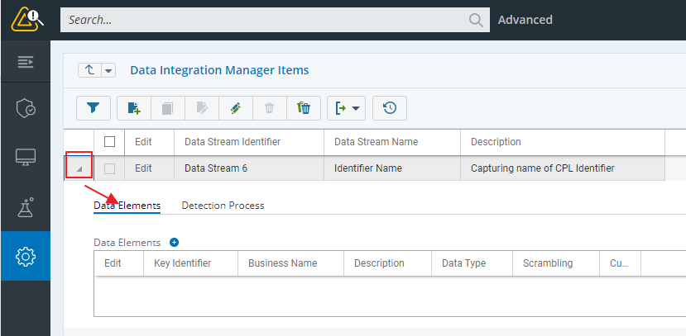
Notes:
Once you define a data stream, Click the arrow icon in the first column to configure fields further for the data streams. The Data Elements and Detection Process tabs are displayed.

Slide 12
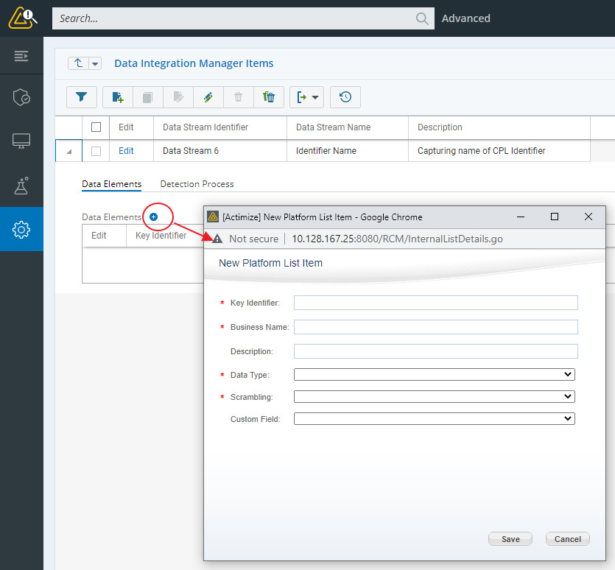
Notes:
In the Data Elements tab, Click the Add item to list Data Elements (+) icon to specify various information like Key Identifier, which is the key in JSON string, Business Name displayed on Policy Manager and Analytics Authoring Environment, data type and Scrambling method when the data is persisted into ADLs.
Based on the new Data Stream field's data type, you can map a Data Stream field with a relevant Client field in the IFM data model.

Slide 13
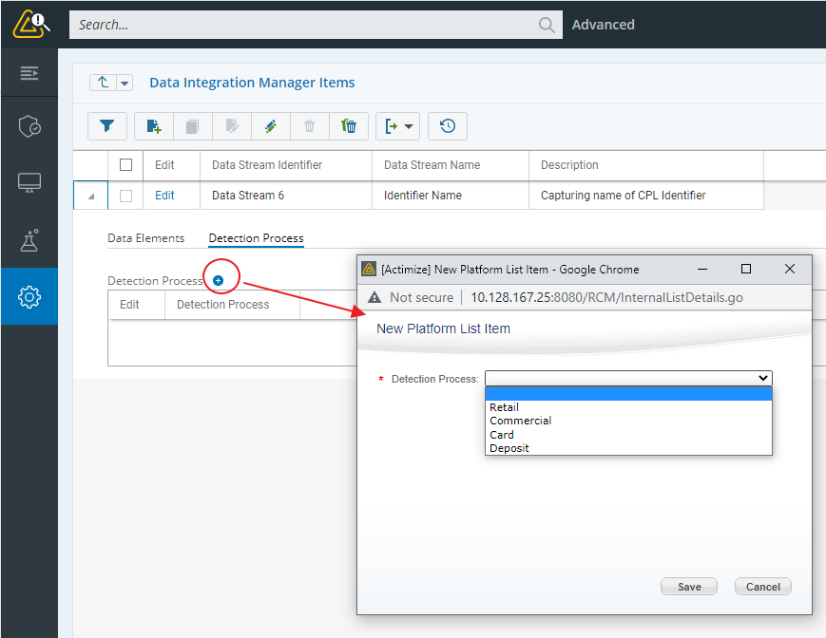
Notes:
Similarly, In the Data Elements tab, Click the Add item to list Data Elements (+) icon and specify the required detection process for the data stream.
Once a data stream is configured, its fields are displayed in policy manager rules, profile and rule contexts in the same way as out-of-the-box IFM fields.

Slide 14
Notes:
Thank you for your time. For more information about any of the Actimize solutions, visit the NICE Actimize DOC Center.

